Slide 1
Intro to JavaScript
Web Campaign Session-4
Raj Bunsha
Github
Vidhish Trivedi
GitHub

Slide 2
Possibilities
What can JavaScript do?
Frontend development
Backend development
Games
Procedural Art
Machine learning
Web3

Slide 3
DEMO

Slide 4
Goals of this session
You will be familiar with the following by end of session
What is JavaScript?
Variables, loops and conditional statements
Add JavaScript to web pages
Document-object model (DOM)
Event Listeners
Demonstration

Slide 5
What is JavaScript
JavaScript is a high-level, object-oriented, multi-paradigm programming language.
But what does that mean?

Slide 6
Some Basics
console.log() and functions
console.log() is similar to print() in python.
function keyword is similar to def in python.

Slide 7

// function and console.log()
function add(a,b)
{
return a+b;
}
console.log(add(5,6));

Slide 8
Variables
const, var, let. . .
const: Used to declare constant variables.
var: Available within the scope of function.
let: Available only within the block where it is declared.

Slide 9
// difference between var, let and const
if(true)
{
var a=5;
let b=6;
const c=100;
c=6; // TypeError: Assignment to constant variable.
}
console.log(a); // 5
console.log(b); // ReferenceError: b is not defined
console.log(c); // ReferenceError: c is not defined

Slide 10
Loops
for, while,do while, forEach. . .s
for
while
do while
forEach

Slide 11
//For loop , while loop and do while loop
for(let i=0;i<5;i++)
{
console.log(i);
}
while(true)
{
console.log("hello");
break;
}
do
{
console.log("hello");
break;
}while(true);
let array=[1,2,3,4,5];
array.forEach(element => {
console.log(element);
});

Slide 12
Conditional Statements
if, ==, !=, >=, >, <, <=, ===. . .
More or less the same as C.
Triple equals ( === ) ?

Slide 13
// Conditionals
let a=5;
if(a=="5")
{
console.log("First Conditional");
}
if(a==="5")
{
console.log("Second Conditional");
}

Slide 14
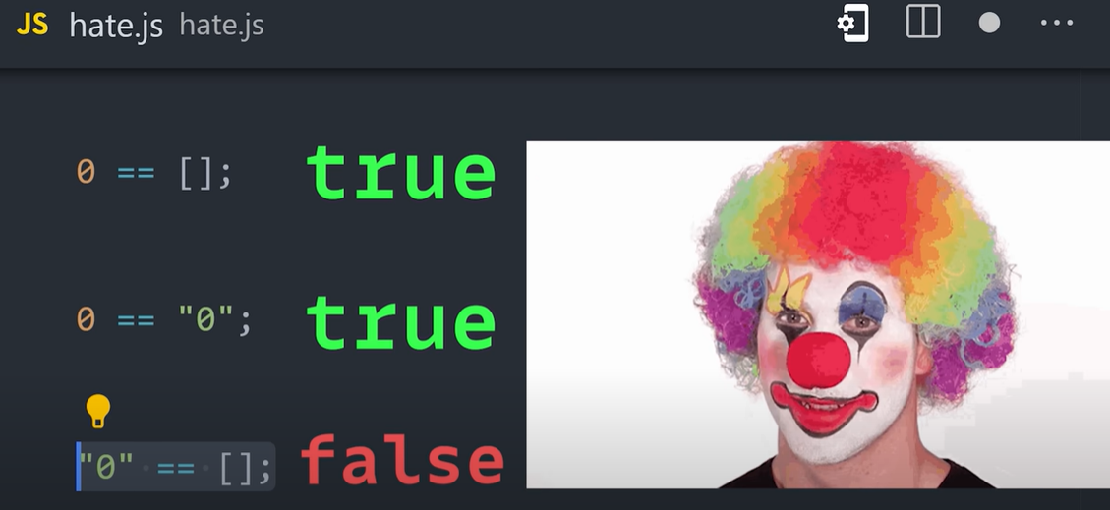

Slide 15
Adding Javascript to web pages
With the object model, JavaScript gets all the power it needs to create dynamic HTML:
JavaScript can change all the HTML elements, attributes, and CSS styles in the page
It can add / remove HTML elements and attributes
It react to all existing HTML events in the page
It can create new HTML events in the page

Slide 16
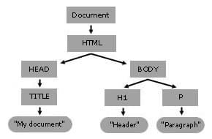
DOM
What is DOM?
DOM stands for document object model.
The HTML DOM API provides access to various browser features such as tabs and windows, CSS styles and stylesheets, browser history, and so forth.
Notes:
An API provides abstractions to the user in form of functions and objects so that they can easily use them, without worrying about the underlying implementation.

Slide 17
Event Listener
How are events managed?
Examples of HTML events:
When a user clicks the mouse
When a web page has loaded
When an image has been loaded
When the mouse moves over an element
When an input field is changed
When an HTML form is submitted
When a user strokes a key
Notes:
Events: Whenever the state of an HTML element changes, an event is triggered.
Event Listeners: Functions that can be attached to elements and are triggered when an event occurs.

Slide 18
<style>
#btn{
background-color: red;
color: white;
padding: 10px;
border: none;
border-radius: 5px;
cursor: pointer;
}
/* Changing this into js */
#btn:hover{
background-color: green;
}
</style>
//JS Equivalent code of :hover
<script>
var btn = document.getElementById("btn");
btn.addEventListener("mouseover", function(){
btn.style.backgroundColor = "green";
});
btn.addEventListener("mouseout", function(){
btn.style.backgroundColor = "red";
});
</script>
btnHover (codepen.io)
EventsExample (codepen.io)

Slide 19
Hands-On
Starting code: Vidhish-Trivedi/GDSC-WC4 (github.com)

Slide 20
Thanks For Attending!
Happy Coding!
Raj Bunsha
Github
Vidhish Trivedi
GitHub

